Slide 1
Barangay System
Notes:
The name of our project is Barangay System. Our main objective as requested by our client is to help improve the systems processes in our government. As a student we are only limited to contribute a small part in this planned innovation. So the plan is to start the improvement in the lowest form of the government which is the barangay.
We did our research. We went to two different barangays, barangay bangkal and barangay merville, and we asked them what are the problems they encounter regarding their system and problems in the way they process their documents and store records.
Some of the problems include Data redundancy, loss of records, complicated document processes and unorganized data strorage.
For our project, we were able to create a system for the barangay that covers and solves all these problems and can help benefit the citizens in the barangay and at the same time help the barangay officials in managing their constituents.

Slide 2
Project Authors
Professor
Mr. Manuel Sanchez
Project Adviser/s
Ms. Roselle Gardon
Mr. Ernesto Boydon
Project Team
Kamila Lagman
Christian Ansel Sevilla
David Warren Arcellana
Jhonel Deluna
Notes:
Good morning everyone! My name is Ansel Sevilla …..
We are here to present our finals project in Introduction to Analysis and Design but before anything else, we would like to introduce our client Sir Abner Arieta. Thank you very much for coming sir, we really appreciate your time.
We would also like to thank our adviser Ms. Rocelle Gardon and Sir Boogie. And of course our professor Sir Sean Sanchez.

Slide 3
Table of Contents
Target Audience
General Objectives
Specific Objectives
Project Description
Project Plan
Event table
Use case diagram
Use case full description
Data flow diagram
DFD Fragments
Level 0
Level 1
Entity relationship diagrams
Activity diagram
Data dictionary
Gantt chart
Screenshots of proposed system
Notes:
So here are the contents of our presentation

Slide 4
Target audience
Our focused users will be the barangay citizens and officials. Helping them in managing and securing their records.

Slide 5
General Objective
Create organized and secured information details for the barangay citizen to provide fast and accurate transactions. Help lessen complications such as information redundancy caused by repetitive registration and avoid missing data thus leading to successful document processes.
Educate the citizens by providing them with appropriate content of information and giving them easy access to this information.
Notes:
Our general objective is to
We also aim to

Slide 6
Barangay Citizen
Event | Trigger | Source | Use Case | Response | Destination
Citizen checks for the services available | Check Service | Barangay Citizen | Show details of services | More details about the service | Barangay Citizen
Citizen chooses available service | Select Service | Barangay Citizen | Select Service | Display detailed information about the service | Barangay Office
Citizen requests for documents | Request document | Barangay Citizen | Request for document | Display sample document | Barangay Citizen
Citizen wants to register to the barangay | Register | Barangay Citizen | Citizen Registers | Display application form | Barangay Citizen
Submit required document | Submit requirements | Barangay citizen | Submit requirements | Requirements details | Barangay official
Notes:
Next is our event tables that will be discussed by my groupmate, warren.

Slide 7
Barangay Official
Event | Trigger | Source | Use Case | Response | Destination
Barangay Official check request document | Check Request | Barangay Officials | Check document request | Show Document Requests | System
Barangay Official verifies citizen’s identity | Check POI/POA | Barangay official | Send request | Request details | Government agency/ external
Barangay official updates content of Bulletin / Citizen/ Service/ Requirements | Update | Barangay Officials | Update Bulletin / Citizen/ Service/ Requirements | Show update details | System

Slide 8
Government Agency/ External
Event | Trigger | Source | Use Case | Response | Destination
Verifies citizen submitted document | Document verification | Government agency/ external | Verify submitted document | Verification details | Barangay official

Slide 9

Use Case Diagram
Barangay Citizen
Show Details of service
Select Service
Request for document
Citizen Registers
Submit Requirements

Slide 10

Use Case Diagram
Check document request
Barangay Official
Update Bulletin / Citizen/ Service/
Requirements
Send Request

Slide 11
Use Case Diagram
Government Agency/ External
Verify submitted document

Slide 12
Fully Description
Use Case Name: | Select Service
Scenario: | User will select type of service
Trigger Event: | Select Service
Brief Description: | System displays different services, allowing user to choose and select services and display more info about the chosen service.
Actors: | User
Related Use Cases: | Show details of service
Stakeholders: | Barangay Citizen
Preconditions: | Citizen must view list of services
Post conditions: | System displays more details about the selected service
Flow of Activities: | Actor | System
 | 1. User selects desired service | 1.1 System displays detailed information of the service
Notes:
Now we will discuss our event tables.
The first event is select service
This is where the user will select the type of service

Slide 13
Use Case Name: | Request for document
Scenario: | Citizen wants to request for document
Trigger Event: | Request document
Brief Description: | If the citizen has selected the chosen document, the system will get the information of the citizen from the database and transfer that information to the requested document.
Actors: | User, System
Related Use Cases: | Select service
Stakeholders: | Barangay citizen
Preconditions: | Citizen must be registered to the system
Post conditions: | The request will be successfully placed
Flow of Activities: | Actor | System
 | 1. The user requests for document | 1.1 Displays various documents 1.2 User Login
 | 2. User submits request | 2.1 The system verifies if the user is registered 2.2 The system will place request in the database
Exception Conditions: | The citizen cannot request for a document if the computer that the user is using lost or does not have connection.

Slide 14
Use Case Name: | Citizen registers
Scenario: | The user wants to register
Trigger Event: | Register
Brief Description: | The user wants to register to the barangay system to make use of the system’s services
Actors: | User, System
Related Use Cases: | Request for document
Stakeholders: | Barangay citizen
Preconditions: | User is not in the systems database
Post conditions: | User’s details will be stored to the system
Flow of Activities: | Actor | System
 | 1. User wants to register | 1.1 show application form
 | 2. User submits form | 2.1 System saves user details
Exception Conditions: | The citizen cannot proceed with the registration process if the computer that the user is using does not have internet connection

Slide 15
Use Case Name: | Submit requirements
Scenario: | The user will submit requirements
Trigger Event: | Submit requirements
Brief Description: | The user will be required to submit to certain requirement for the verification.
Actors: | User
Related Use Cases: | Citizen registers
Stakeholders: | Barangay citizen
Preconditions: | The citizen must request for document
Post conditions: | The submitted requirements will be placed in the system for verification
Flow of Activities: | Actor | system
 | 1. User will submit requirements based on the requested document | 1.1 The submitted requirements will be saved in the system
Exception Conditions: | If the citizen was not able to attach the requirement to be submitted properly, Then the citizen cannot submit requirements successfully.

Slide 16
Use Case Name: | Check Document Request
Scenario: | The barangay official wants to check the requested document(s) of the citizens
Trigger Event: | Check Request
Brief Description: | The barangay official checks the requests of the citizens
Actors: | Admin/Barangay officials
Related Use Cases: | Request document
Stakeholders: | Barangay official/Citizen
Preconditions: | There must be a request document from the citizen.
Post conditions: | Barangay officials can see and check requested documents.
Flow of Activities: | Actor | System
 | 1. Barangay official checks request of the citizen | 1.1 The system outputs the requested documents of the citizen
Exception Conditions: | If there is no requested document from the citizen then there is no requirements to be checked.

Slide 17
Use Case Name: | Send request
Scenario: | Barangay official will send request
Trigger Event: | Check POI/POA
Brief Description: | The barangay official wants to send request to the government agency/external to verify if the submitted requirements of the citizens are legit.
Actors: | Barangay Official
Related Use Cases: | Check document request
Stakeholders: | Government agency/external, Barangay citizen, Barangay official
Preconditions: | There should be a submitted requirement from the citizen
Post conditions: | Requests will be sent to the government agency/ external
Flow of Activities: | Actor | System
 | 1. Barangay official will send request to government agency
Exception Conditions: | If there is no requested document from the citizen then there is no requirements to be verified.

Slide 18
Use Case Name: | Update Bulletin
Scenario: | The barangay official updates Bulletin / Citizen/ Service/ Requirements
Trigger Event: | Update
Brief Description: | The barangay official updates the content of Bulletin / Citizen/ Service/ Requirements
Actors: | Barangay Official
Related Use Cases:
Stakeholders: | Barangay Official, Barangay Citizen
Preconditions: | There should be a database to be updated
Post conditions: | Contents of the Bulletin / Citizen/ Service/ Requirements will be updated
Flow of Activities: | Actor | System
 | 1. Barangay official updates Bulletin / Citizen/ Service/ Requirements | 1.1 The contents of the Bulletin / Citizen/ Service/ Requirements will be updated
Exception Conditions: | Barangay official cannot update if there is no database.

Slide 19
Use Case Name: | Verify submitted document
Scenario: | Government agency/external verifies the requests of the barangay official
Trigger Event: | Document verification
Brief Description: | If the Government agency/external received the request of the barangay official, they will verify the legitimacy of the citizen’s requirements.
Actors: | Government agency/external and Barangay official
Related Use Cases: | Send request
Stakeholders: | Barangay Official/ Barangay citizen
Preconditions: | Barangay official must send request first in order for the Government agency/external to verify the request.
Post conditions: | The requirements submitted by the citizen has been verified
Flow of Activities: | Actor | System
 | Government agency/external verifies the request of the barangay official Barangay official updates the citizen’s request status. | 2.2 Citizens record will be updated
Exception Conditions: | If the barangay official fails to contact the government agency/external then the submitted document of the citizen cannot be verified.

Slide 20
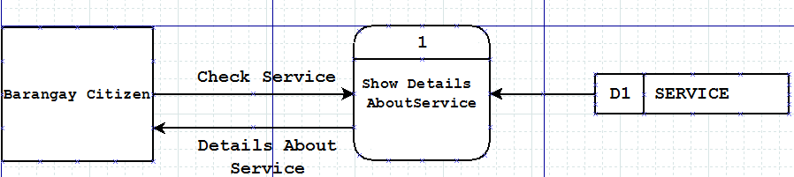
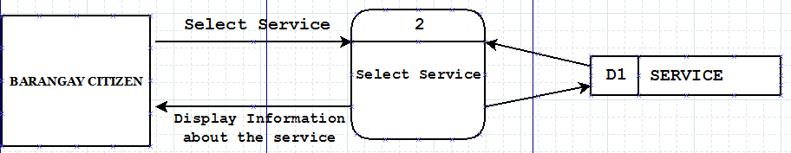
DFD Fragments

Slide 21
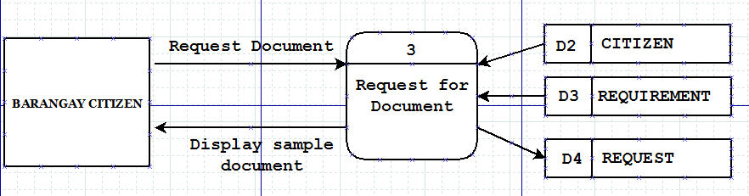
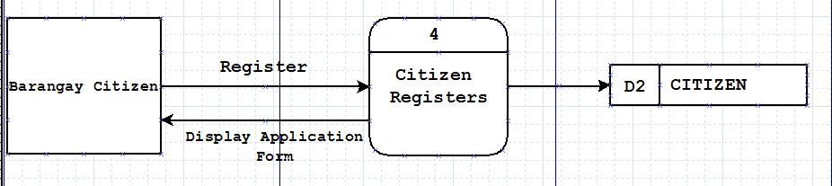
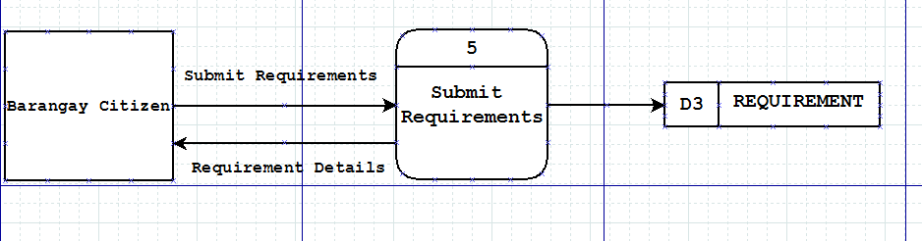

Slide 22
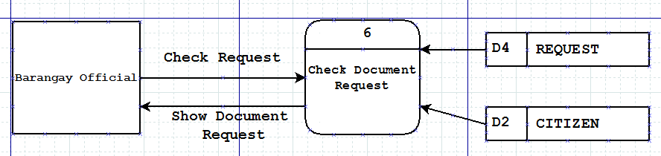
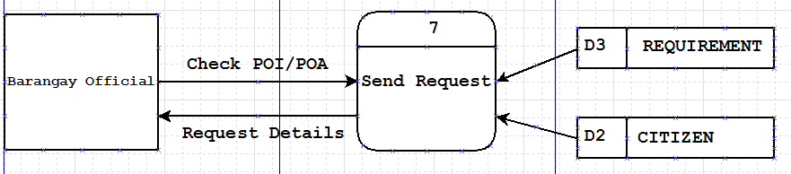
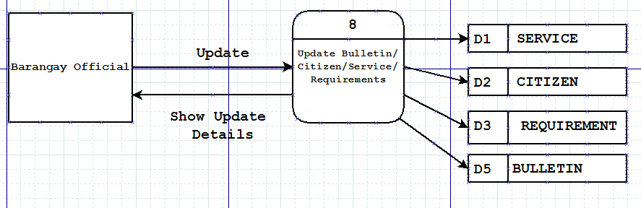

Slide 23
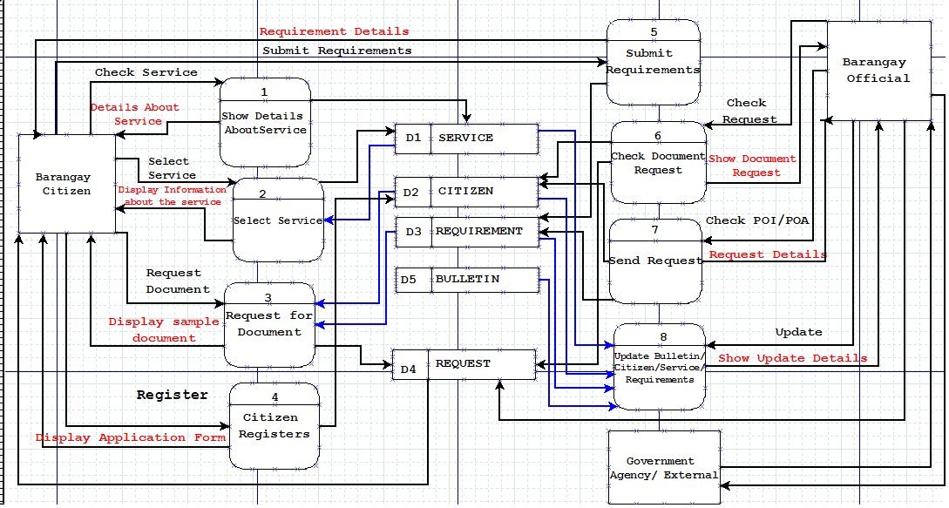
Level 0

Slide 24
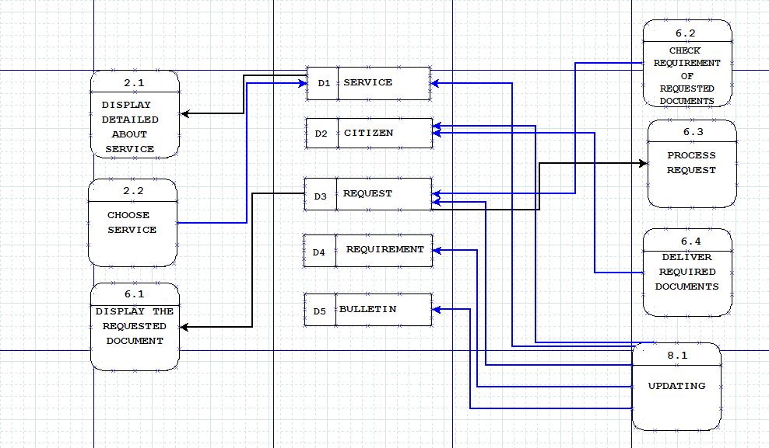
Level 1

Slide 25
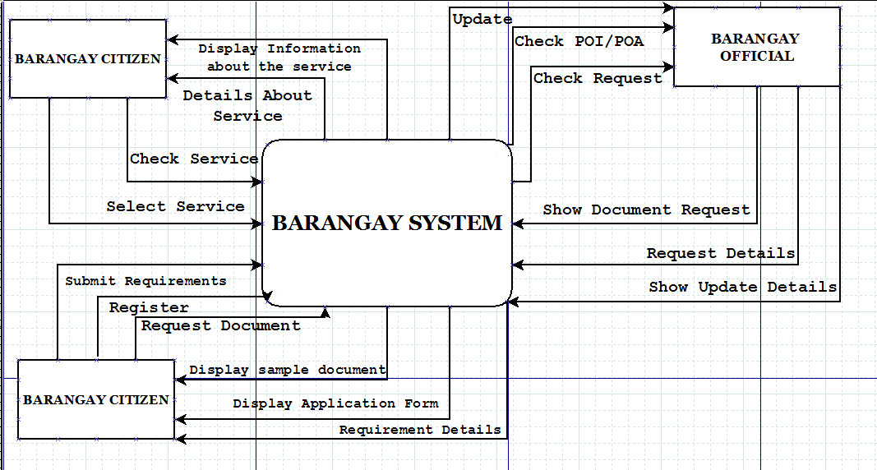
Context Diagram

Slide 26
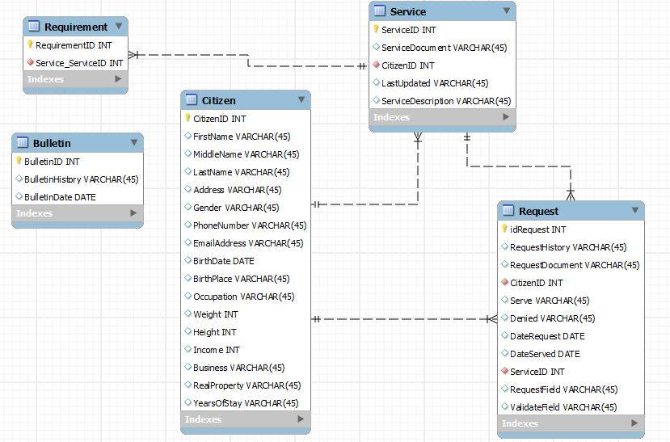
Entity Relationship Diagram

Slide 27
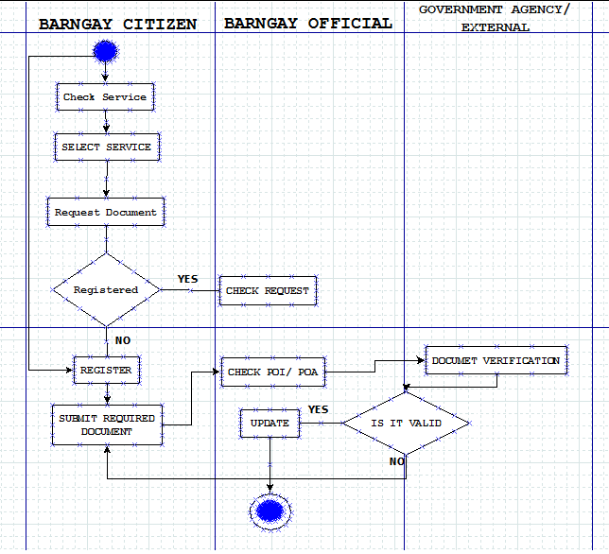
Activity Diagram

Slide 28
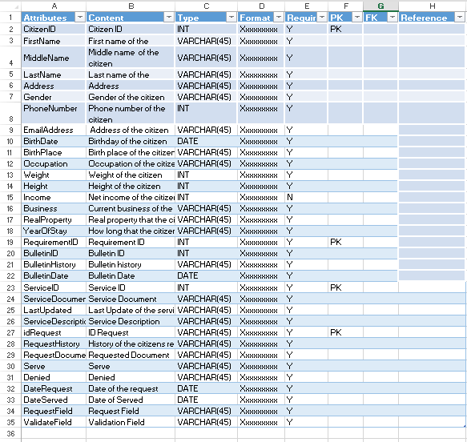
Data Dictionary

Slide 29
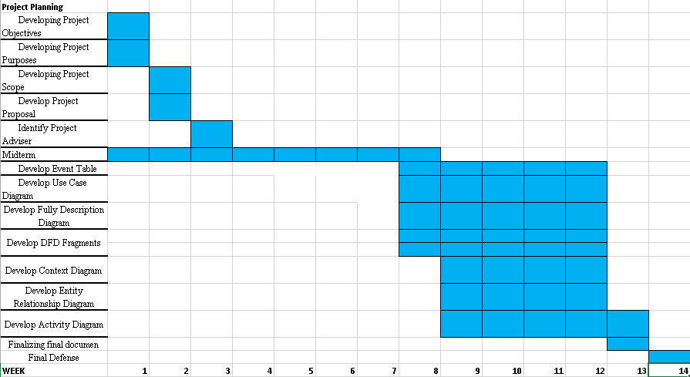
Gantt Chart

Slide 30
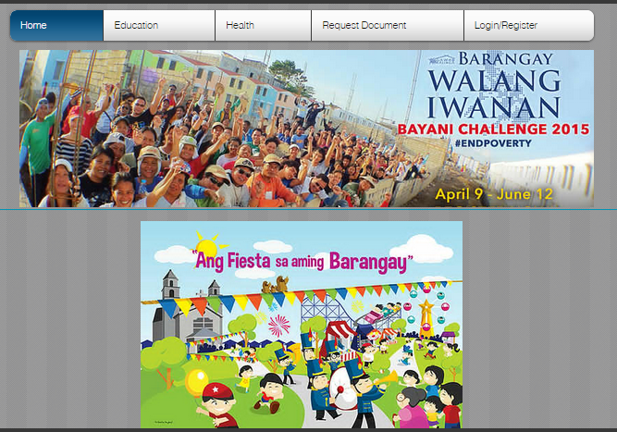
Screenshots of proposed system

Slide 31
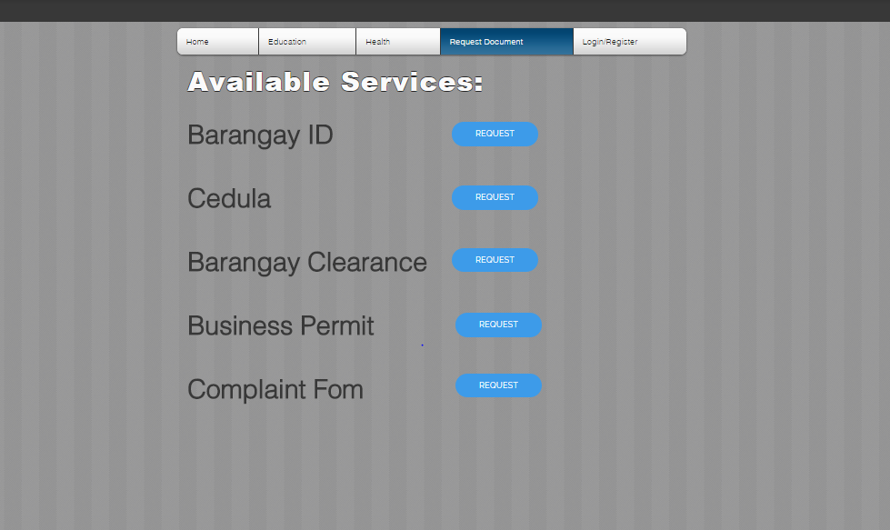

Slide 32
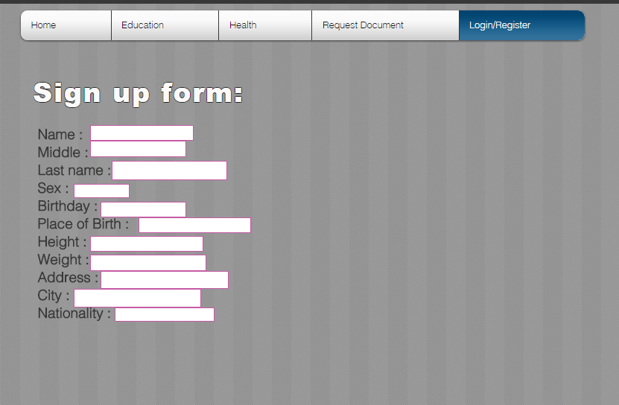

Slide 33
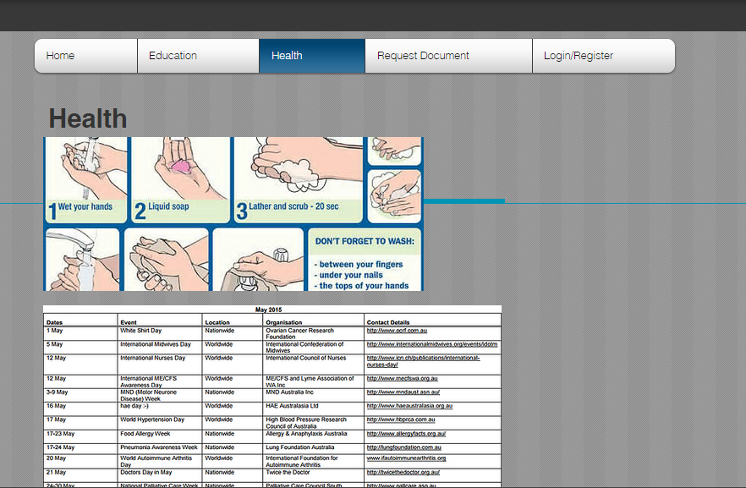

Slide 34
